Slide 1
Scala
Chapter 3

Slide 2
Basics
Scala is used in building modular, scalable, and fast software. It is most commonly used by data engineers along with Apache Spark to process large amounts of data smoothly and efficiently. Since Scala runs on JVM, Java and Scala stacks are seamlessly integrated.
Performance: Scala is a compiled language, which generally leads to better performance compared to interpreted languages like Python. Its strong static typing and JVM optimizations make it highly efficient, allowing for faster execution of Spark applications
Each Scala collection has method par, which makes it parallel, meaning that all combinators (map, reduce etc) will be executed in parallel.
MapReduce is a programming model used for efficient processing in parallel over large data-sets in a distributed manner.

Slide 3
Scala handles distributed data processing by using abstractions that hide the complexity of distributed systems and allow you to write concise and declarative code. For example, Spark, a popular framework for large-scale data analysis, uses Scala as its primary language and provides a distributed collection
Scala is known to be a statically typed language, where the data type for the variable is defined before it is used. The type checking is done at compile-time rather than at the run time. It is also a "Strongly Typed" language where the variables are checked before having an operation in it.

Slide 4
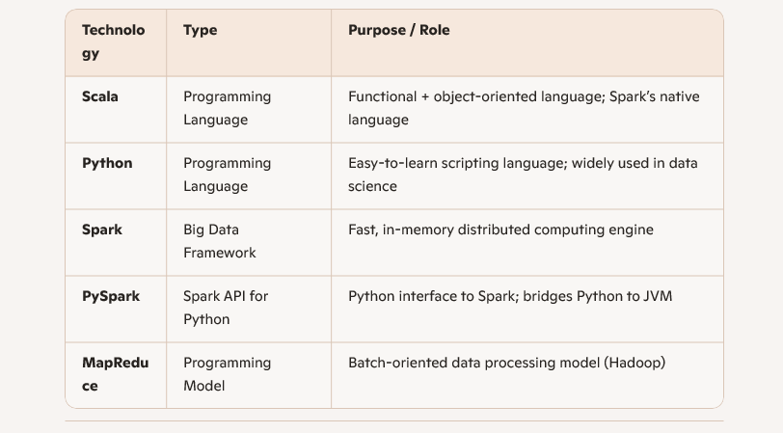
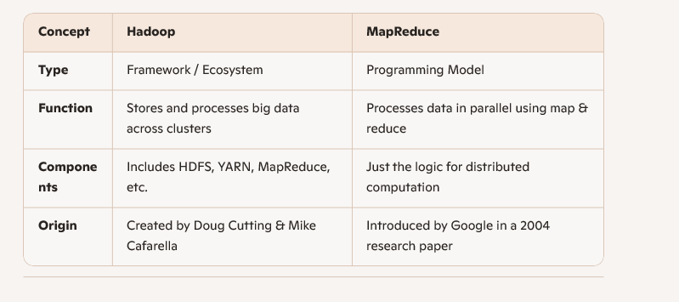
Python vs Scala vs Spark vs Pyspark vs MapReduce

Slide 5
Programs
object HelloWorld {
def main(args: Array[String]): Unit = {
println("Hello, World!")
val s="hi"
print(s)
val s1: String = " How are you!"
s1=" change"
print(s1)
}
}
def main(args: Array[String]): Unit = {: This line defines the main method, which is the entry point of the program. It takes an array of strings (args) as its parameter and returns Unit (similar to void in other languages)
object hello { def main(args: Array[String]) = { println("Hello, World!") } } In this code, we defined a method named main , inside a Scala object named hello . An object in Scala is similar to a class , but defines a singleton instance that you can pass around.
Singleton object is an object which is declared by using object keyword instead by class. No object is required to call methods declared inside singleton object. In scala, there is no static concept. So scala creates a singleton object to provide entry point for your program execution.

Slide 6
Var vs val
object VariablesDemo {
def main(args: Array[String]): Unit = {
val immutableVar: String = "This can't be changed"
var mutableVar: Int = 10
mutableVar = 20 // Works fine since it's declared as 'var'
println(immutableVar)
println(mutableVar)
}
}

Slide 7
Looping Statements and Function
object LoopExample {
def main(args: Array[String]): Unit = {
// for loop
for (i <- 1 to 5) {
println(s"Iteration $i")
}
// while loop
var count = 3
while (count > 0) {
println(s"Countdown: $count")
count -= 1
}
}
}
object FunctionDemo {
def greet(name: String): String = {
s"Hello, $name!"
}
def main(args: Array[String]): Unit = {
println(greet("Sasikala"))
}
}

Slide 8
object HelloWorld {
def main(args: Array[String]): Unit = {
println("Hello, World!")
val s="hi"
print(s)
//val s1: String = " How are you!"
var s1: String = " How are you!"
s1=" change"
print(s1)
var (x, y, z) = (5, 4.5, "Sit")
print(x,y,z)
z=5.5
}
}

Slide 9
object HelloWorld {
def main(args: Array[String]): Unit = {
println("Hello, World!")
val s="hi"
print(s)
//val s1: String = " How are you!"
var s1: String = " How are you!"
s1=" change"
print(s1)
var (x, y, z) = (5, 4.5, "Sit")
print(x,y,z)
//z=5.5 error
var globalVar = 10
def sub(){
var difference = 9-4;
print(difference)
}
//print(difference)//Error
print(globalVar)//Valid
sub() } }

Slide 10
Scala Installation in VS code
Getting Started with Scala and sbt on the Command Line | Scala Documentation (scala-lang.org)
Variables in Scala | DataCamp
https://youtu.be/fcl9dLmWhgo

Slide 11
